Slide 1
Graph Embedding
Name ID
Shahar Berenson 208608414
Shlomi Fridman 318187002
Omer Goldstein 205906258
Notes:
Model flow and model architecturte

Slide 2



Members
Shlomi Fridman
Omer Goldstein
Shahar Berenson

Slide 3
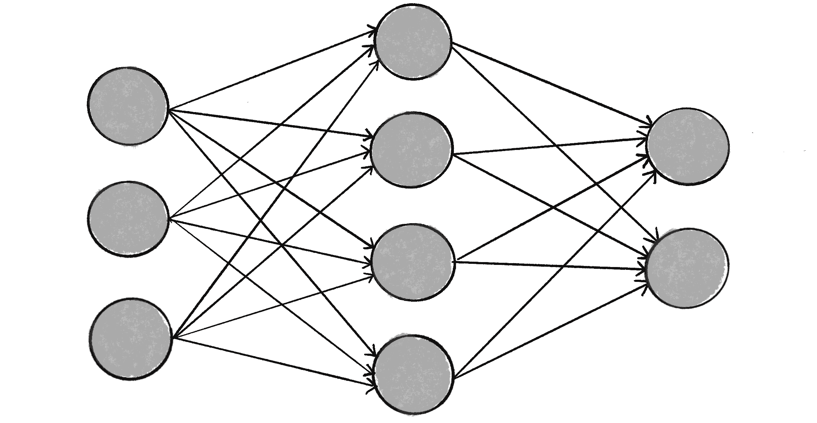
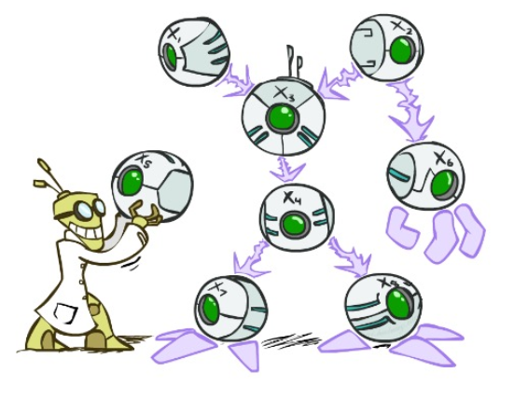
Introduction
This is the works for the final project of the “Data Mining and Learning systems“ course in Braude College (Winter 2025)
We’ll explain the implementation of two network graph embedding algorithms (Deepwalk, node2vec) for one dataset (Cora)

Slide 4
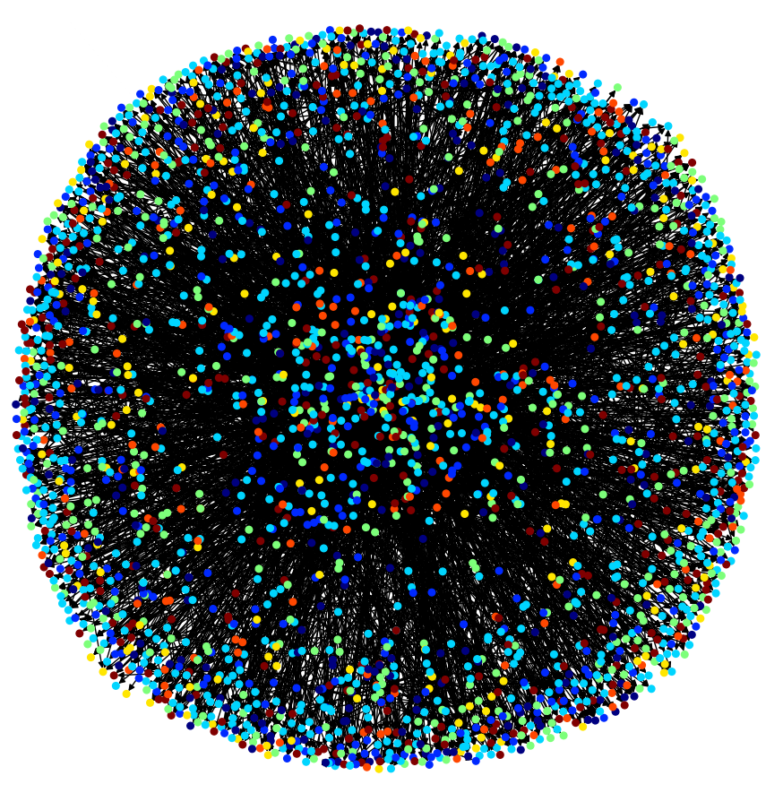
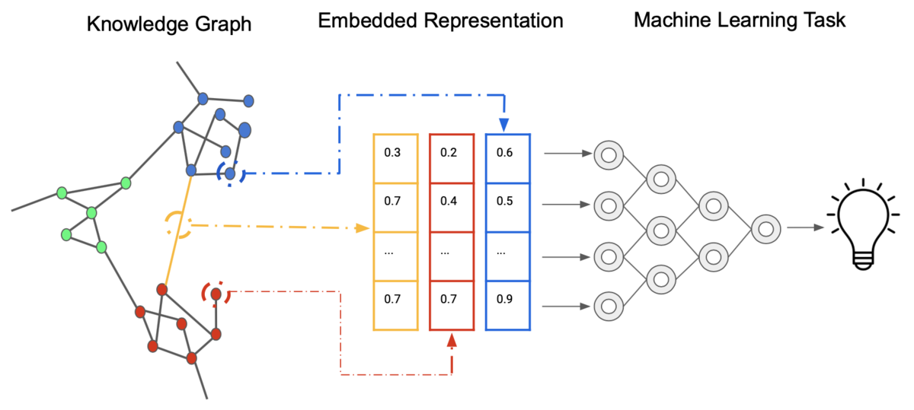
Problem definition
Graph embedding represents graph data as low-dimensional vectors, capturing its structure and relationships for easier use in machine learning tasks.

Slide 5
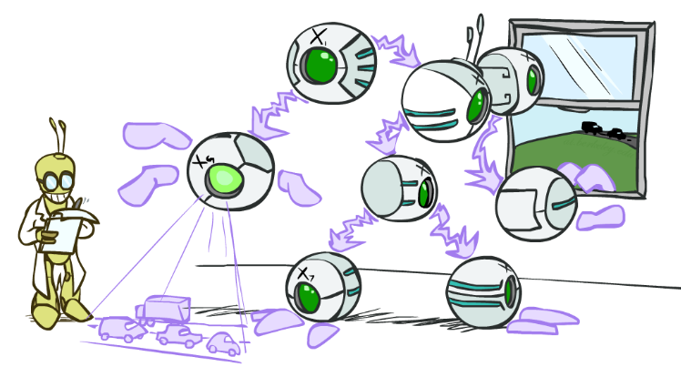

Objective
Develop a graph embedding model that can transform nodes and edges into meaningful vector representations. These embeddings will be used to solve specific tasks such as node classification, link prediction, community detection, or graph clustering.

Slide 6
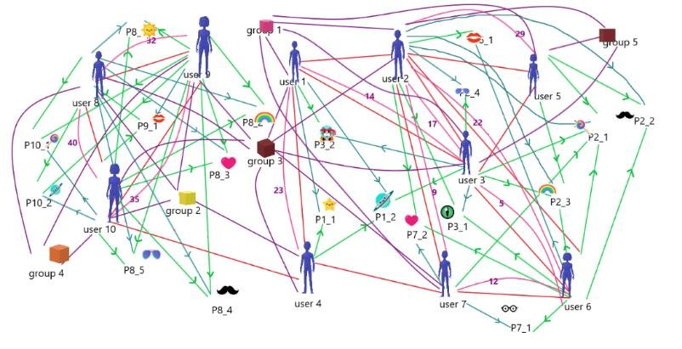

Examples of Graph-Embedding Usage
Social Media Platforms (Facebook, Twitter, LinkedIn)
Predict friendship connections based on interactions.
Streaming services (Netflix, YouTube)
Recommend videos based on past viewing.
Academy Research
Use citation networks to classify research papers.

Slide 7

Analyze the dataset
The Cora dataset consists of Machine Learning papers.
There are 2708 papers.
These papers are classified into one of the following seven classes:
- Case_Based
- Genetic_Algorithms
- Neural_Networks
- Probabilistic_Methods
- Reinforcement_Learning
- Rule_Learning
- Theory

Slide 8


Analyze the dataset
After stemming and removing stopwords we were left with a vocabulary of size 1,433 unique words.
All words with document frequency less than 10 were removed.

Slide 9
Analyze the dataset
The dataset consists of two files:
Cora.content: (Papers as Nodes)
Matrix of <paper_id> <word attributes> <class label>
Word attribute values are 0 or 1 whether each word is present in paper
Example:
Cora.cites: (Cites as Edges)
Matrix of <ID of cited paper> <ID of citing paper>
Example: 35 1033
Paper_id | W1 | W2 | W3 | … | W1433 | Class_label
950052 | 1 | 0 | 0 | … | 0 | Neural_Network
35
weight
1033

Slide 10
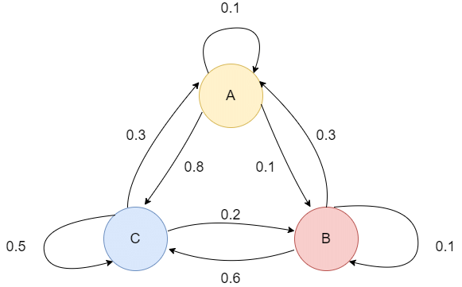
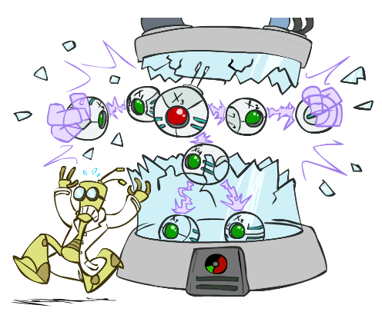
Prepare the dataset
The vertexes are loaded from the “Cora.content” file
The edges are loaded from the file “Cora.cites” file
Both are converted to a diGraph from the networkxx library
Both vertexes and edges are given probability using the Alias method.
Alias method –
Each vertex and edge are given a weight value in range of [0,1]
Vertexes – Based on a discrete probability distribution
Edges - based on its neighbors and on biased random walk.
Notes:
DiGraph—Directed graphs with self loops alias explaining later
1/p if nei=src 1/q if not connected, else normal

Slide 11
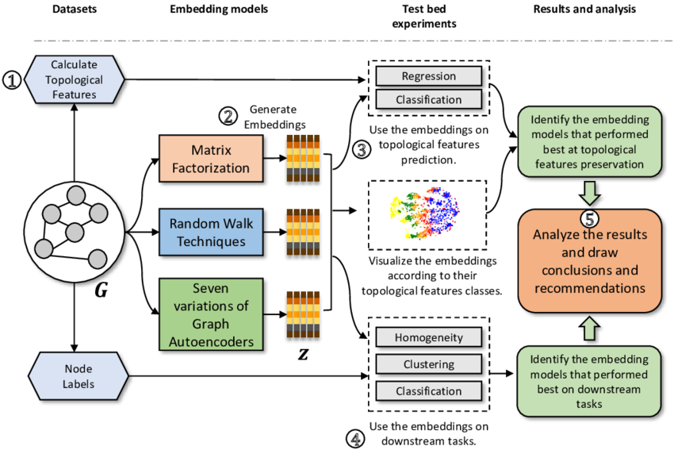
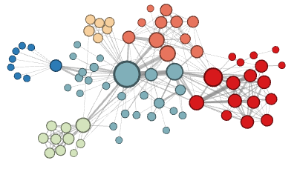
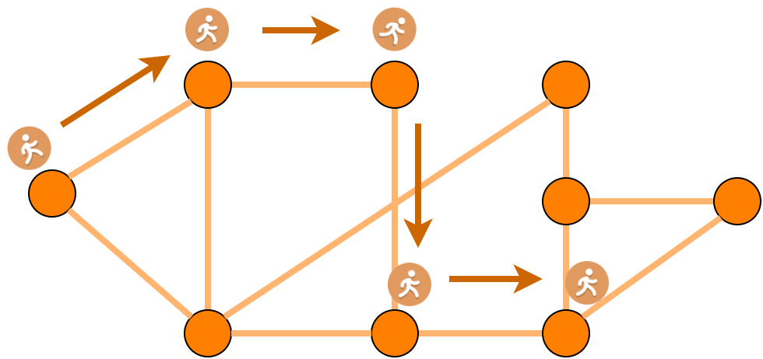
Models used
DeepWalk
Node2Vec

Slide 12
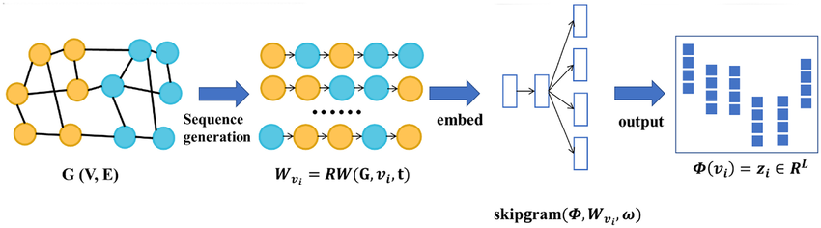
DeepWalk Model
DeepWalk is a method for learning representations of nodes in a graph. The core idea behind it is to generate random walks within the graph, which are then used to learn representations of the nodes.
•Random Walks: DeepWalk generates a set of random walks starting from each node in the graph. A random walk is a sequence of nodes that begins at a particular node and moves to one of its neighbors at each step, revealing relationships between nearby nodes.
•Word2Vec Algorithm: The random walks generated from the graph are treated as "sentences," and the nodes in the graph are treated as "words". The algorithm is applied to these random walks to learn a neural network. This network predicts the probability of a node appearing in a random walk given its neighbors in the graph.
•Local Structure: DeepWalk is effective at capturing the local structure of a graph. This allows it to learn node embeddings that reflect the immediate relationships between nodes.

Slide 13
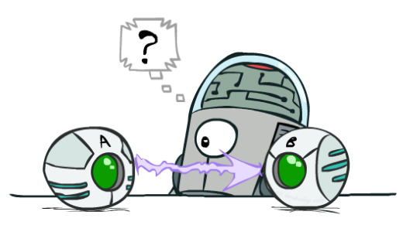
Node2Vec
DFS and BFS: Node2Vec combines DFS and BFS techniques to extract random walks. This combination is controlled by two parameters, P (return parameter) and Q (in-out parameter).
Key differences:
•DeepWalk uses simple random walks, while Node2Vec uses a more flexible approach with P and Q parameters to control the walk's behavior.
•Node2Vec combines the advantages of BFS and DFS through its sampling strategy, giving it more control over the nature of the learned representations than DeepWalk.
P (Return Parameter): Controls the likelihood of returning to the previous node in the walk. A high value of P makes the random walk explore further, while a low value keeps the walk localized
Q (In-Out Parameter): Controls the likelihood of exploring nodes further away (BFS-like behavior) or staying local (DFS-like behavior). A small value of Q promotes exploration, while a large value encourages the walk to stay local

Slide 14
Create the model
For each node in the alias graph, it starts 1,000 random walks. The walks are with the following parameters:
For Deepwalk: p=q=1
For Node2Vec: p=5, q=1
walk_length = 100
The model is built with the word2Vec library. It runs random walks with params.
vector_size = 200 // representation of each node
epochs = 5 // iterations
The model gives each node its context based on the walks the algorithm created
Notes:
Sg=1, target word to other words
it guesses the context of the surrounding words
SG=0, it guesses the context of the word based on its surrounding

Slide 15
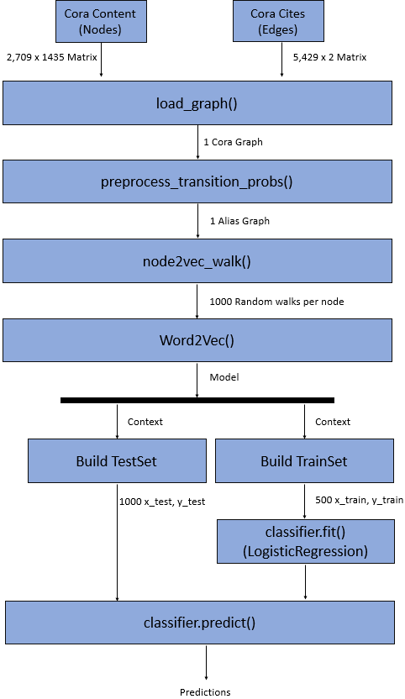
Model steps
Preprocess:
Load vertexes and edges
Build the graph
Give probability to vertexes and edges (Alias Graph)
Generate random walks
Build Word2Vec Model
Generate Context
Split Train and Data sets
Train Classifier
Test Classifier

Slide 16
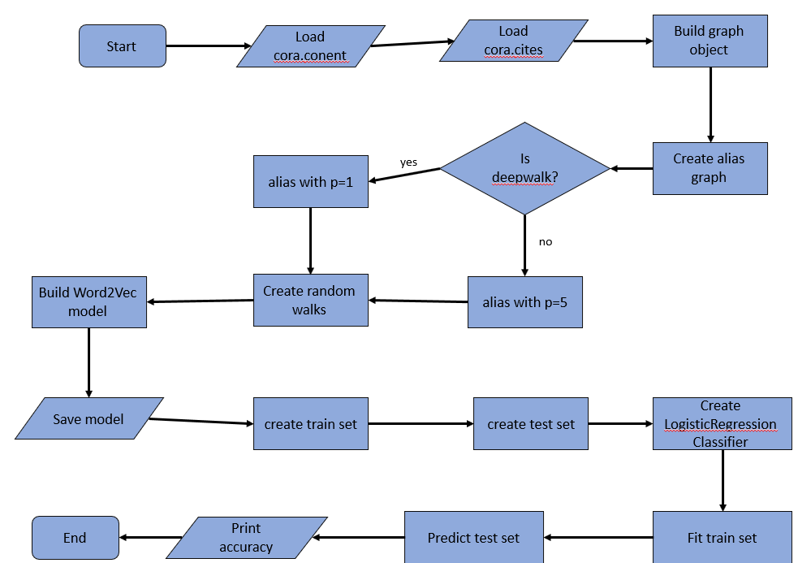
Model Architecture
Create Context
The model uses DeepWalk/Node2Vec (Unsupervised models) random walks to do graph embedding and give context to each node.
Create, train, and test the classifier.
The classifier is LogisticRegression (Supervised model) from package sklearn.linear_model
The train data that was given context is fitted into the classifier
The classifier predicts the test data and are compared to the true test labels.
Flow chart

Slide 17

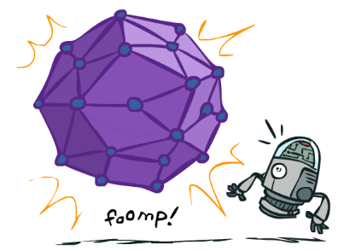
Fit the model
Each context is taken from the word2Vec object.
The model splits the data to train and test datasets.
First 500 are taken into the training set and the following 1000 into testing set
The train data is fitted into the classifier LogisticRegression to train the model
The classifier is called to make the predictions on the test set.
The model prints the accuracy of the algorithm

Slide 18
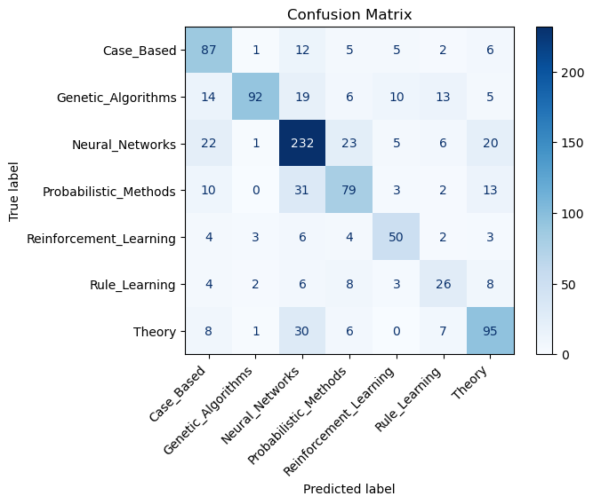
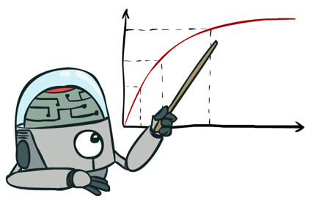
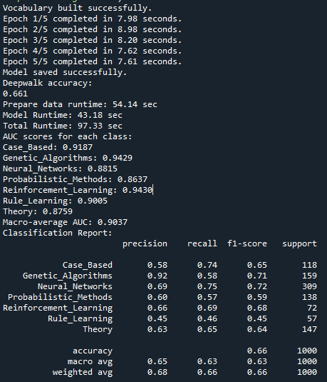
Evaluate the model (Deepwalk)
Notes:
F-measure: 2 / ( (1 / Precision) + (1 / Recall) )
P = tp / (tp+fp)
R = tp / (tp+fn)

Slide 19

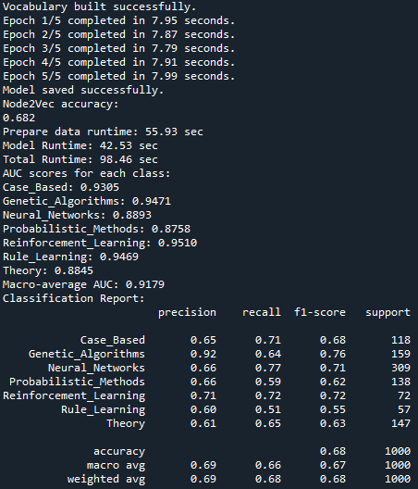
Evaluate the model (Node2Vec)
Notes:
F-measure: 2 / ( (1 / Precision) + (1 / Recall) )
P = tp / (tp+fp)
R = tp / (tp+fn)

Slide 20

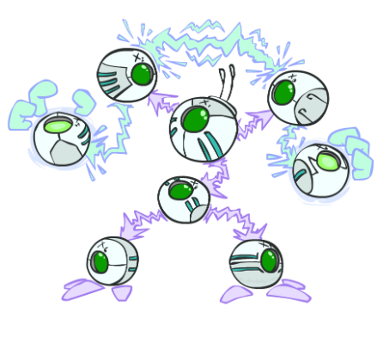
Summary
The Node2Vec runs have slight better scores than DeepWalk. (Specifically, in F1 and AUC scores)
Due to a wider exploration area in the graph
F1 scores in range of 60-70%
This might be because of implementation of the algorithms and the used dataset in the given project
AUC scores in range of 90-95%
one class is much more frequent, the model can predict the majority class often, leading to low accuracy while still ranking positive cases correctly (high AUC)

Slide 21

Reference
dedekinds (Spring 2018), Graph-Embedding
DeepWalk: Online Learning of Social Representations. Bryan Perozzi, Rami Al-Rfou, Steven Skiena. KDD 2014.
node2vec: Scalable Feature Learning for Networks. Aditya Grover, Jure Leskovec. KDD 2016
Deep Walk and Node2Vec: Graph Embeddings, Tejpal Kumawat, medium, 2023
Skip-Gram Word2Vec Algorithm, Ido Leshem, medium, 2023

